Slide 1

WORLD BANK
Bank Churn Explained
BY EXCEL
Presented by NILOY SAHA

Slide 2
Understanding Bank Churn
Importance in Banking
Bank churn refers to the loss of customers over time, significantly impacting financial institutions’ profitability and growth. Understanding its drivers is essential for enhancing retention and business success.

Slide 3
Industry Churn Statistics
Understanding Current Trends
Customer churn in the banking sector remains a critical issue, One source reports that financial-services firms (including banks) have churn rate of ~19 %, underscoring the need for strategic retention initiatives to enhance customer loyalty.

Slide 4
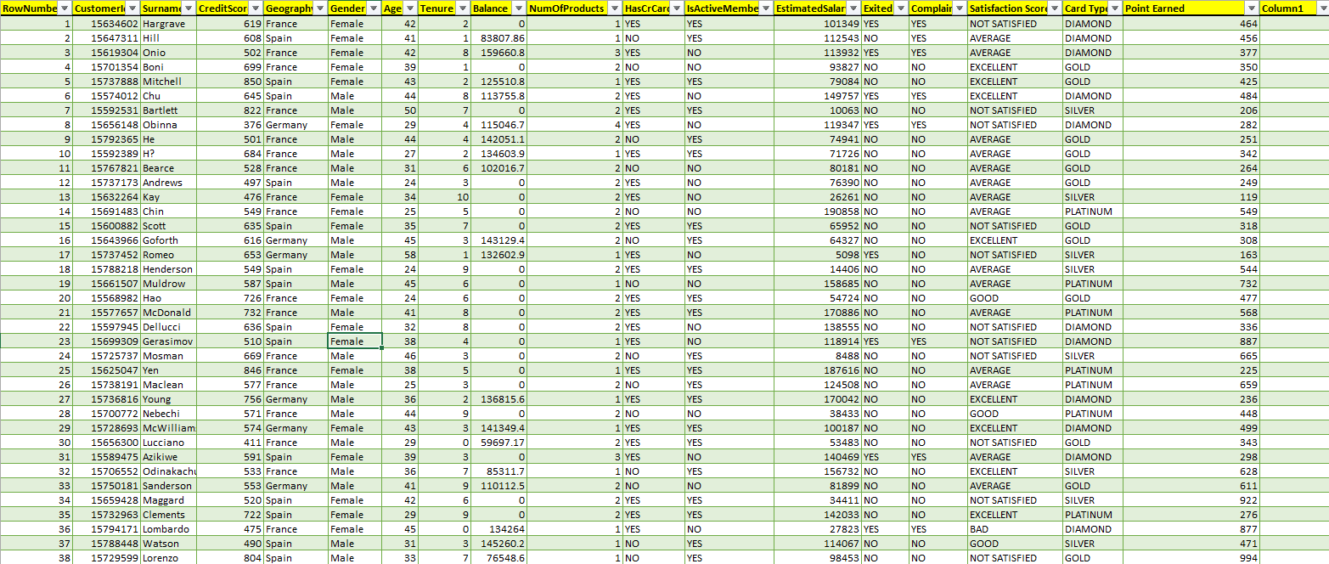
OVERVIEW OF OUR DATA SET

Slide 5
Presentation Agenda Overview
Causes, Impacts, Strategies
This section outlines the key topics to be discussed: the underlying causes of bank churn, its significant impacts on financial performance, and effective strategies to reduce customer attrition.

Slide 6
Insights Overview
There are total 10000 customers in our bank
In our bank 54.6% of customers are male and 45.4% are female
Customers of our bank are from France , Germany, Spain
Overall, 20.38% of total customers have left our bank services

Slide 7

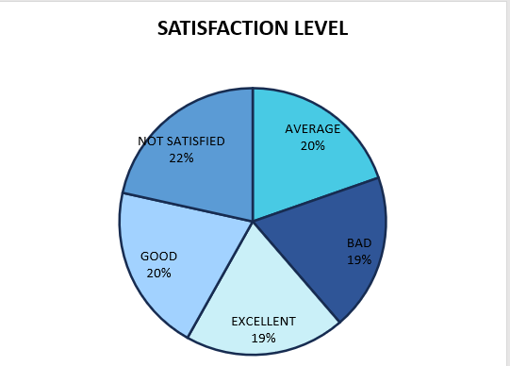
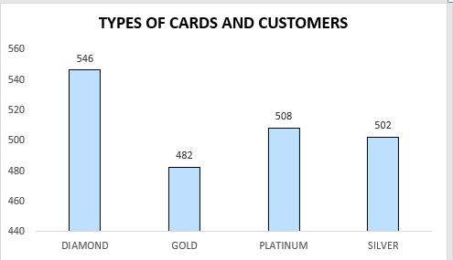
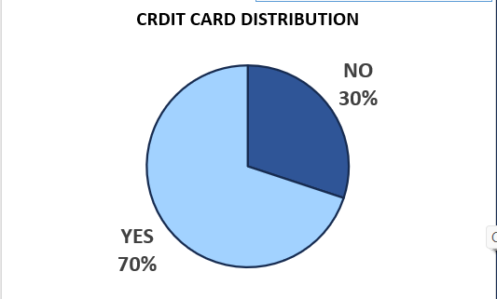
Gender wise contribution
Churn Drivers
Key Factors Behind Attrition
Overall female show higher attrition than male
Service Dissatisfaction
Failing to Meet Cardholder Standards
70% of credit card holders left
Many customers leave due to poor service experiences. In our data 22% are not satisfied ,and only 39% of total customer feel satisfied with our services
It is evident that our bank's Diamond and Platinum cardholders have left our company in the greatest numbers.
Our data indicates that the majority of our credit card holders (70%) have departed from our banking services.

Slide 8
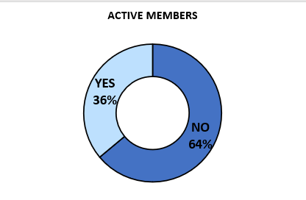
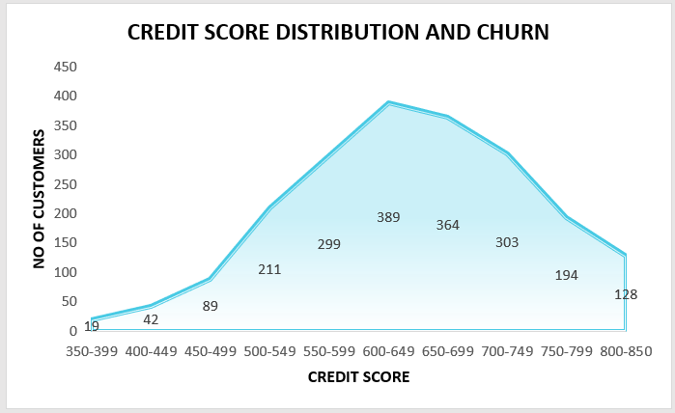
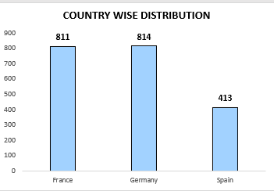



Variations in Active Customers
Credit score impact
Country wise impact
In our bank, 48% of the total customers are inactive. Additionally, out of those who have left, 64% are non-active customers.
It indicates that customers with better credit scores, which reflect their reliability, have left our bank.
Customers of Germany have ceased utilizing our banking services.
The Impact of Complaints
Distribution of Bank Balances
Income of Individuals
99.51% of persons who are complained have left our bank
Customers with larger bank balances often choose to leave their bank.
The significant impact of individual salaries may not be readily apparent.

Slide 9
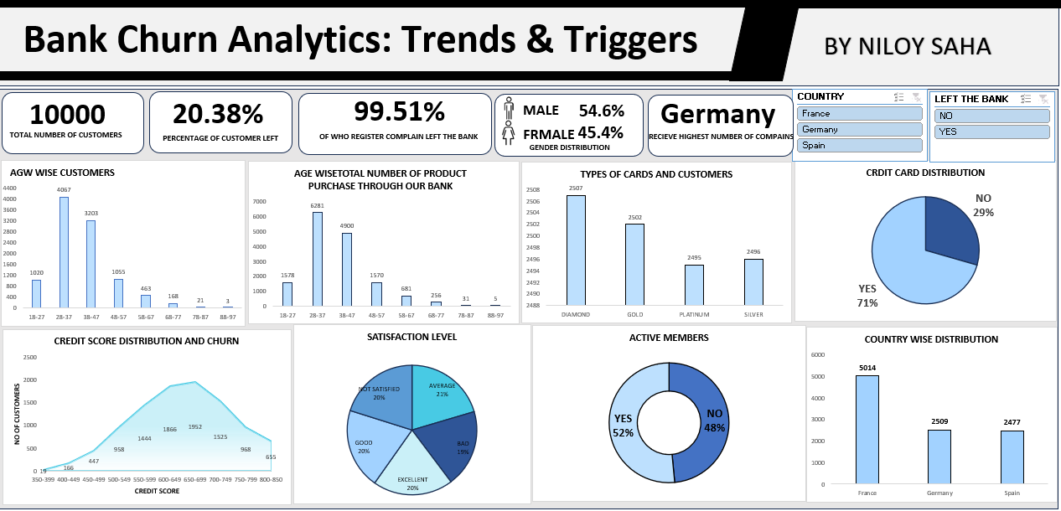
DASHBOARD FOR THIS DATA

Slide 10
Retention Strategies
Enhancing Customer Loyalty
Personalization
Loyalty Programs
Proactive Engagement
To address the issue of low satisfaction, customizing services to meet individual needs helps create a personal connection, which in turn encourages customer loyalty. By leveraging customer data, businesses can improve interactions, increase satisfaction, and ultimately minimize the chances of churn.
Implementing targeted loyalty programs can incentivize at-risk customers to stay. Offering rewards and exclusive benefits drives engagement, making customers feel valued and increasing their long-term commitment to the bank.
Utilizing predictive analytics enables early identification of potential churners. Engaging these customers with personalized outreach and solutions enhances their experience and demonstrates commitment, significantly reducing churn rates.

Slide 11
Enhancing the Experience for Cardholders
Pay close attention to customer complaints.
Special attention to Germany.
Banks can enhance customer engagement by offering tailored rewards programs for platinum, gold, silver, and diamond cardholders, boosting satisfaction. By customizing rewards to suit each card type, banks can provide added value and cater to the unique preferences and spending habits of their diverse clientele.
Listening to customer complaints is key to building loyalty and enhancing your business reputation through effective resolutions.
We must pay special attention to our customers in Germany. It’s essential to communicate with them, provide exclusive offers, and engage them with our banking services.

Slide 12
Key Findings on Churn
Drivers and Business Impact
Understanding the primary drivers of bank churn, like service dissatisfaction and competitive pressure, is essential for improving retention strategies and optimizing long-term customer loyalty in the banking sector.

Slide 13
Thank you for you attention
Presented by
Niloy Saha
Email
nsaha3827@gmail.com
Phone
9836315141

